Slide 1
FLOYD’s ALGORITHM FOR ALL-PAIR SHORTEST PATH PROBLEM

Slide 2
Problem Definition:
Implement All-Pairs Shortest Paths Problem using Floyd's algorithm.
CSE@GIT

Slide 3
Objectives of the Experiment:
To introduce the concept of Dynamic Programming.
Present the working of Floyd’s Algorithm.
To find the shortest path form all nodes to all other nodes in a given graph.
Analyze the Algorithm Complexity.

Slide 4
Dynamic Programming:
Definition:
Dynamic programming is a technique for solving problems with overlapping sub problems.
Dynamic programming suggests solving each of the smaller sub-problems only once and recording the results in a table from which a solution to the original problem can then be obtained.

Slide 5
Theoretical Background:
Underlying Idea of Floyd’s Algorithm
The idea of Floyd’s algorithm is similar to Warshall’s Transitive Closure
Transitive Closure:
If there exists an edge between V_{i} and V_{k} and also between V_{k} to V_{j} then there is a path between V_{i} and V_{j}
Vij may be larger than Vik and Vkj
_{Then}
_{Vij is replaced by Vik+Vkj}
V^{(k-1)}_{ij}
i
j
V^{(k-1)}_{ik}
V^{(k-1)}_{kj}
k

Slide 6
Theoretical Background of All Pair shortest path
The problem: find the shortest path between every pair of vertices of a graph
The graph: may contain negative edges but no negative cycles
A representation: a weight matrix where W( i, j)=0 if i=j. W( i, j)=∞ if there is no edge between i and j. W( i, j)=“weight of edge”

Slide 7
ALGORITHM Floyd(W[1..n, 1..n],n)
//Implements Floyd’s algorithm for the all-pairs shortest-paths problem
//Input: The weight matrix W of a graph with no negative-length cycle
//Output: The distance matrix of the shortest paths’ lengths
D ←W , P [i, j] <- 0 // Distance matrix <- Weight matrix
for k←1 to n do //k is intermediate node
for i ←1 to n do // i is source node
for j ←1 to n do // j is destination node
{ D[i, j ]←min{D[i, j ], D[i, k]+ D[k, j]} , P[i,j] <- k }
return D
Initial Call: Floyd(W[ ][ ], n)

Slide 8
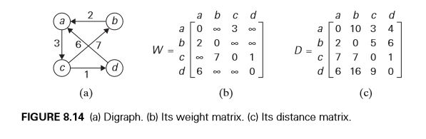
Example

Slide 9
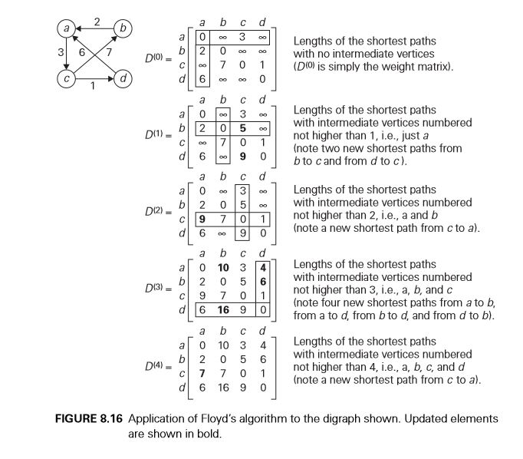
Tracing

Slide 10
Efficiency of Floyd’s Algorithm
Worst-case performance | Θ ( | V | ³ )
Best-case performance | Θ ( | V | ³ )
Average performance | Θ ( | V | ³ )

Slide 11
Learning Outcome of the Experiment and Conclusion
At the end of the session, students should be able to :
Explain the working of Dynamic Programming.
Demonstrate the working of Floyd’s algorithm.
Write the program in C to implement Floyd’s Algorithm.
Estimate the shortest path between All pairs of vertices in a weighted connected graph.

Slide 12
THANK YOU…..

